Slide 1

Sentiment Analyzer

Slide 2

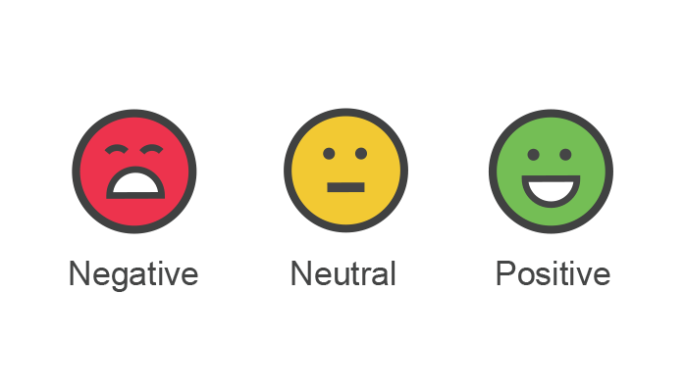
Sentiment analysis is the automated process of identifying and classifying subjective information in text data. This might be an opinion, a judgment, or a feeling about a particular topic or product feature.
The most common type of sentiment analysis is ‘polarity detection’ and involves classifying statements as Positive, Negative or Neutral.

Slide 3
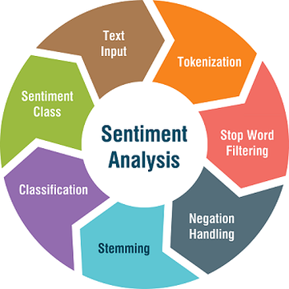
Sentiment analysis is the technique to calculate the polarity of any specific statement. Using NLP cleaning methodologies, we derive the meaningful opinion from the text then calculates the polarity of that opinion, and based on polarity, we classify the nature of the judgment is positive, negative, and neutral.
While performing twitter sentimental analysis, we have to deal with real-time tweets data extracted from different twitter accounts.

Slide 4


Why Sentiment Analysis?
Sentiment Analysis, also known as Opinion Mining, refers to the techniques and processes that help organizations retrieve information about how their customer-base is reacting to a particular product or service.
Sentiment Analysis also uses Natural Language Processing and Machine Learning to help organizations look far beyond just the number of likes/shares/comments they get on an ad campaign, blog post, released product, or anything of that nature.

Slide 5

Why Twitter for Sentiment analysis?
Twitter is a Popular microblogging Site.
Short Text Messages of 140 characters.
200 + million active Users.
500 millions tweets are generated everyday.
Twitter Audience varies from common man to celebrities.
Users often discuss current affairs and share personal views on various subjects.
Tweets are small in length and hence unambiguous.

Slide 6
Sentiment Analysis on Twitter Data
Performing sentiment analysis on Twitter data involves five steps:
Gather relevant Twitter data.
2. Cleaning data using pre-processing techniques.
3. Create a sentiment analysis machine learning model.
4. Analyse Twitter data using sentiment analysis model.
5. Visualize the results of Twitter sentiment analysis.

Slide 7
For fetching the real-time data from twitter, the sentiment Analyzer require all requests to use OAuth for Authentication.
Tweepy provides functionalities in a straightforward way for Authentication.
steps for the registering twitter client application :
Open “https://developer.twitter.com/apps” and click on the button: ‘Create New App.’
Fill all the required application details.
Once the app is created, you will be redirected to the app page.
Open the ‘Keys and Access Tokens’ tab.
Copy ‘Consumer Key’, ‘Consumer Secret’, ‘Access token’, and ‘Access Token Secret’.
We can also regenerate Key, and Token clicked on the Regenerate button.

Slide 8
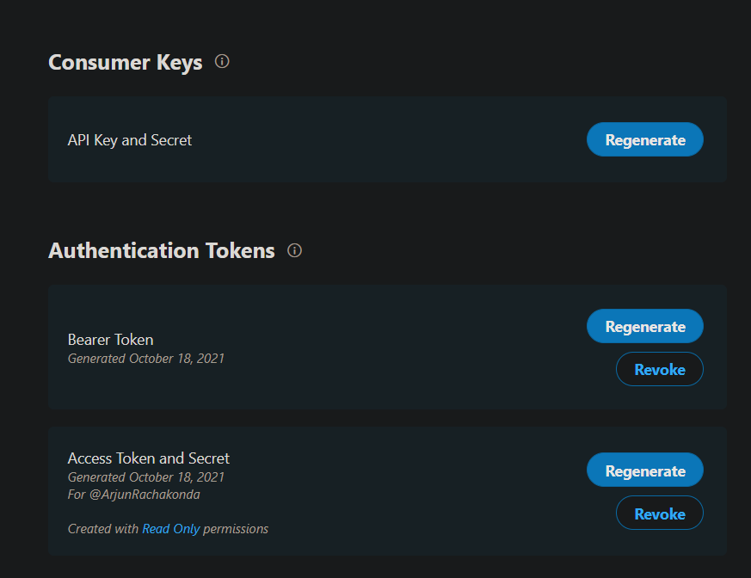
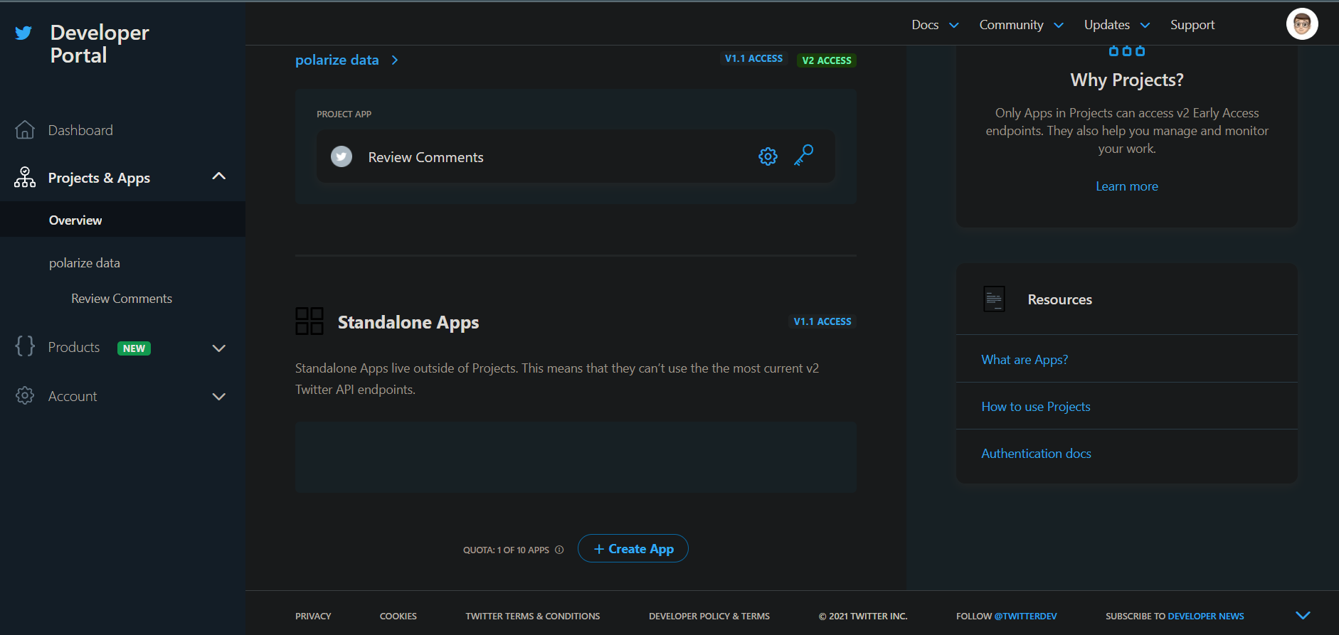
Twitter Developer Portal

Slide 9
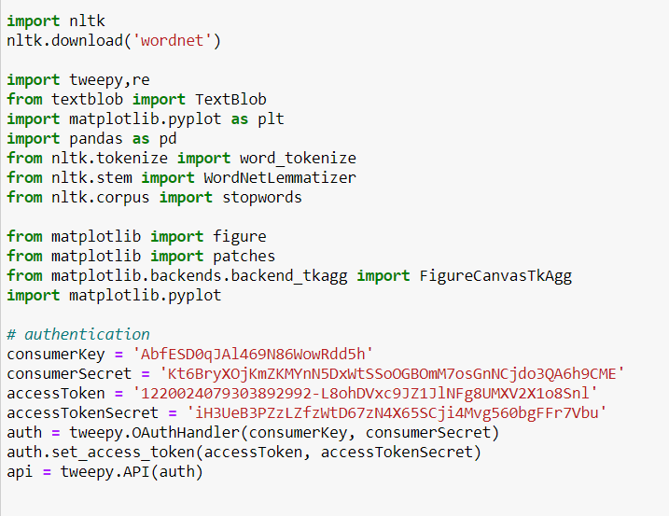
Getting Credentials
Now to extract the tweets from twitter, we need to fill the consumer key, consumer secret, access key, and access secret.

Slide 10
Cleaning the retrieved Data
Now, we fetched real-time tweets from twitter, but now we have to extract meaningful insights from the tweet’s data. For that, we have to clean data because it contains lots of URLs, numbers, and user IDs, which get challenging to analyze tweets.
NLP cleaning methodologies used are;
Word Tokenize
Word Net Lemmatizer
Stop words
Other functions such as Clean_data, drop_numbers, etc.

Slide 11
Challenges
People express opinions in complex ways.
In opinion texts, lexical content alone can be misleading.
Intra-textual and sub-sentential reversals, negation, topic change common.
Rhetorical devices/modes such as sarcasm, irony, implication, etc..
Unstructured and also non-grammatical.
Lexical Variation.
Out of Vocabulary Words.
Extensive usage of acronyms like asap, lol, afaik.

Slide 12
Thank you

